Slide 1
The Down States
Focus: Activity in preparatory period [cue-off go-on]

Slide 2
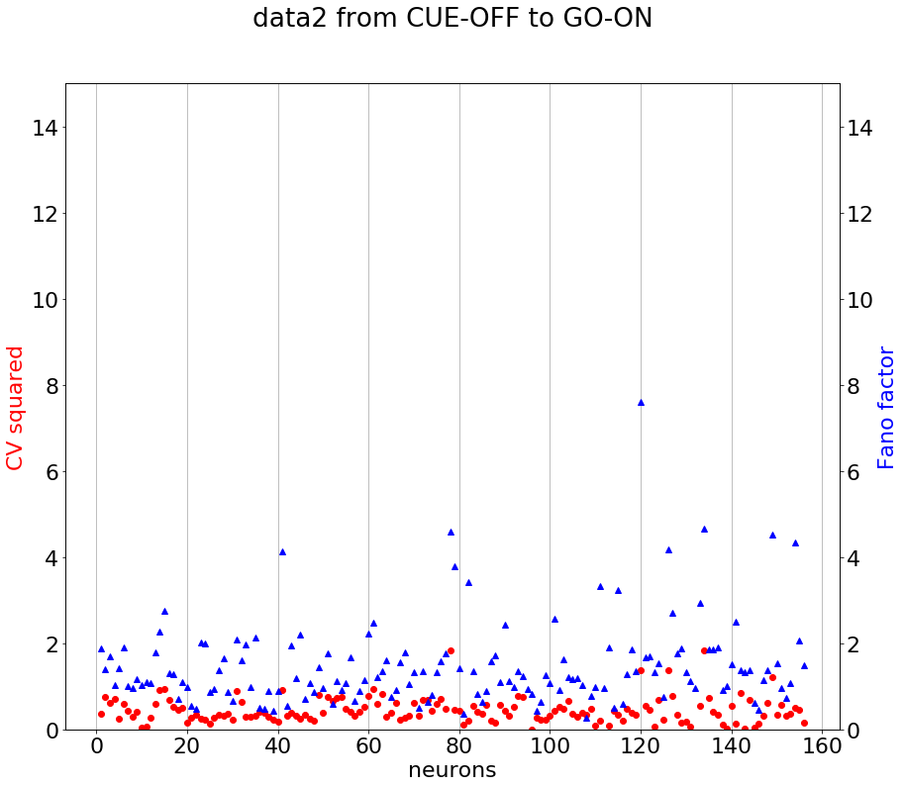
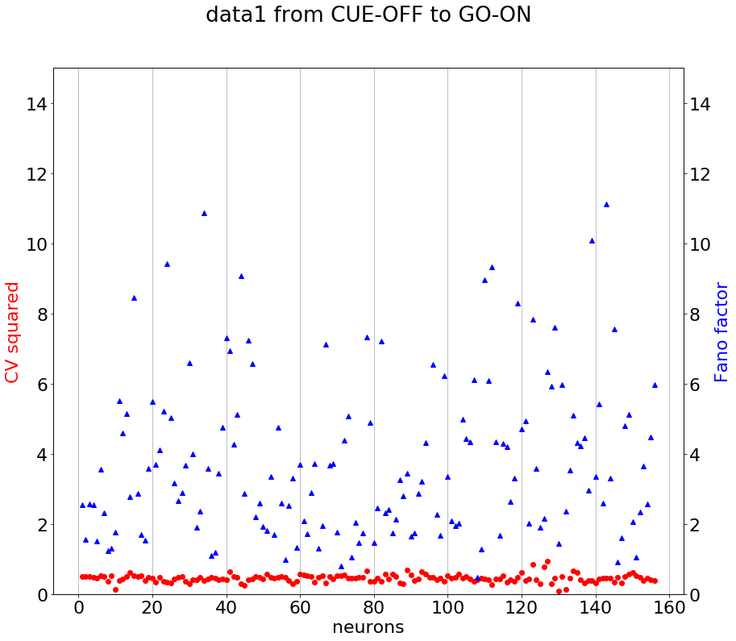
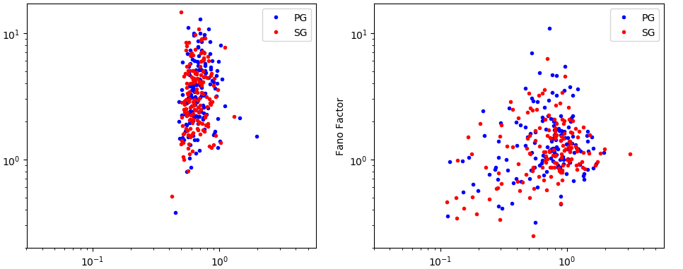
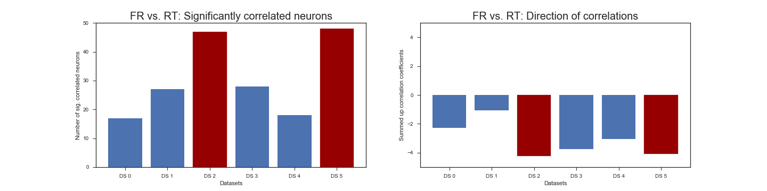
Chain of evidence – Part 1: Dichotomy in the datasets
CV²
vs.
Fano
CV2²
vs.
Fano
Data 0, 1, 3, 4
Data 2, 5
Data 0, 1, 3, 4
Data 2, 5
PCA clusters
Firing Rate vs. RT
Number of significantly correlated neurons
Data 0, 1, 3, 4
Data 2, 5
Datasets

Slide 3
Chain of evidence – Part 2: Dataset 2 & 5 are jittered versions of each other

Slide 4
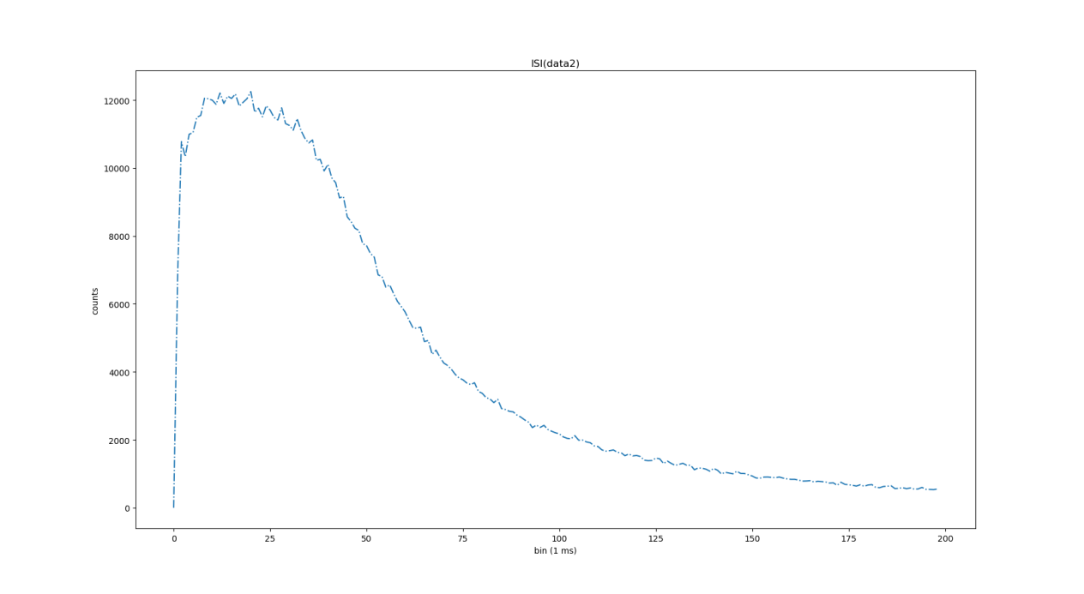

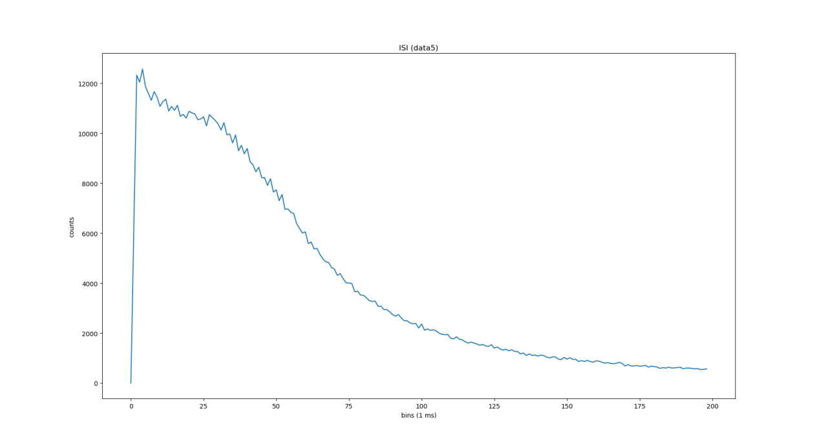

Chain of evidence – Part 3: Is it dataset 2 or 5?
Dataset 2
counts
ISI (1 ms bins)
Dataset 5
counts
ISI (1 ms bins)

Slide 5
Correlations Firing Rate vs. Reaction Time – A closer look

Slide 6
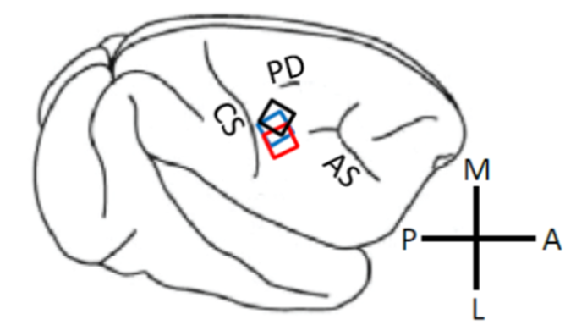
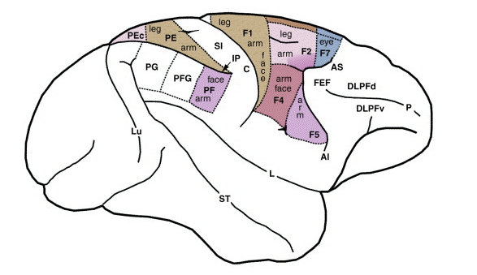
Correlations Firing Rate vs. Reaction Time – A closer look

Slide 7
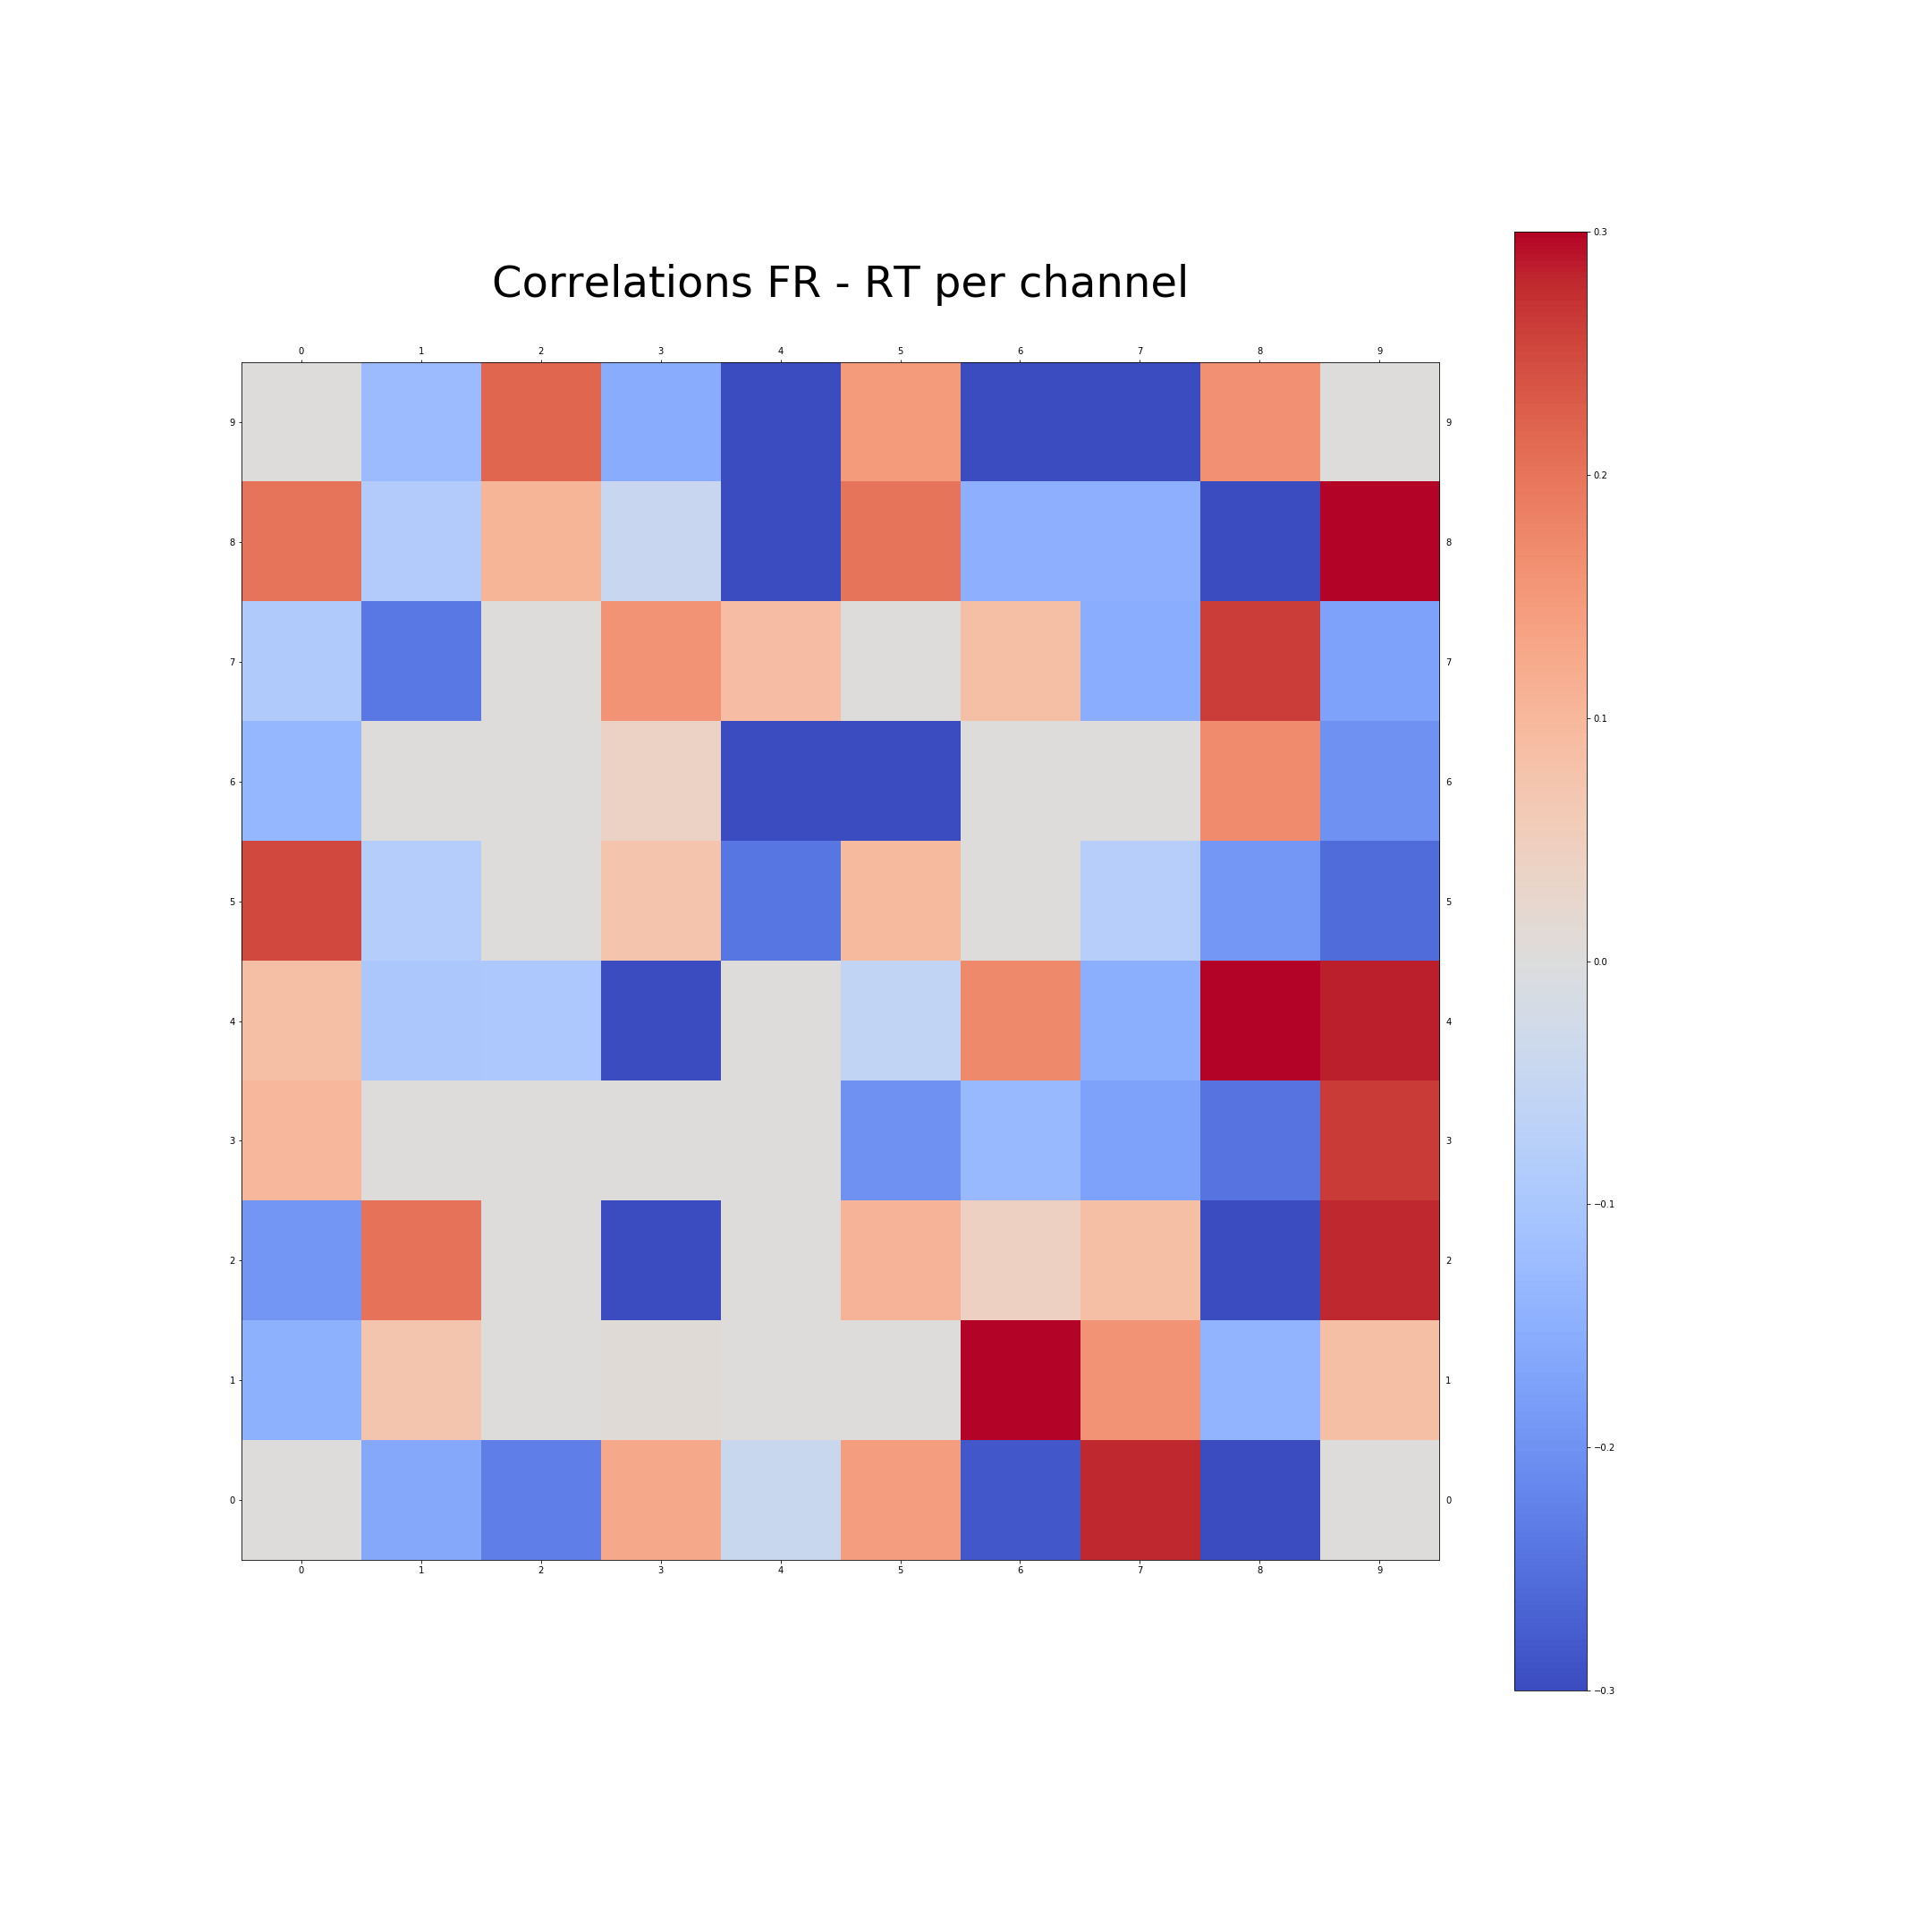
Correlations Firing Rate vs. Reaction Time – A closer look
0.3
0
- 0.3

Slide 8
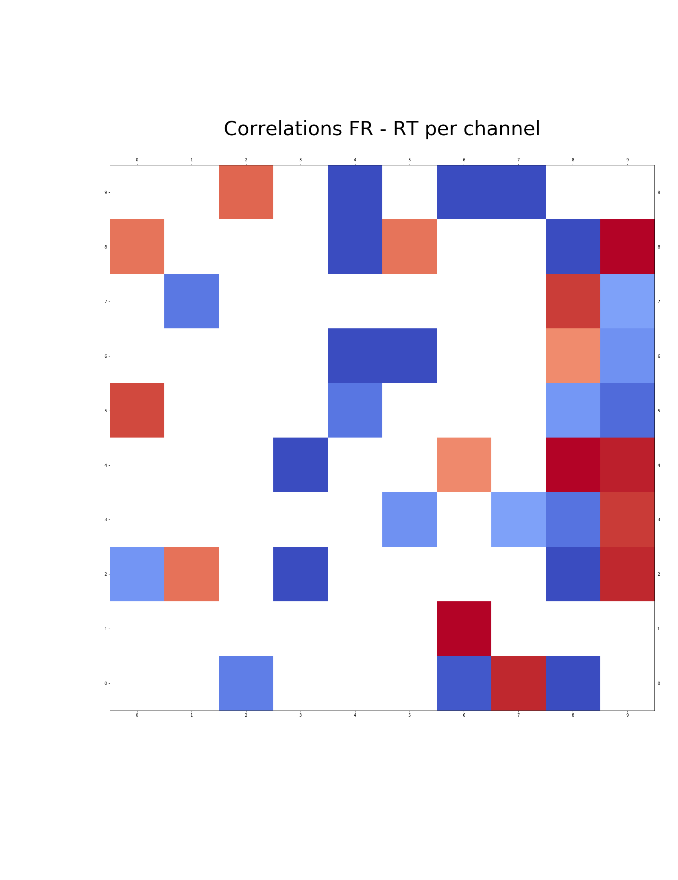
Correlations Firing Rate vs. Reaction Time – A closer look
0.3
0
- 0.3

Slide 9
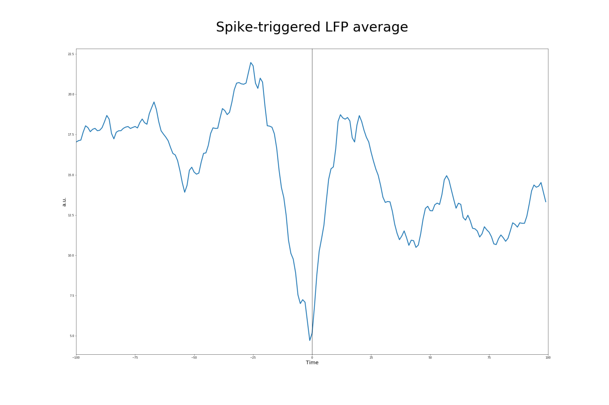
Spike-field coherence
- 100 ms
0 ms
100 ms

Slide 10
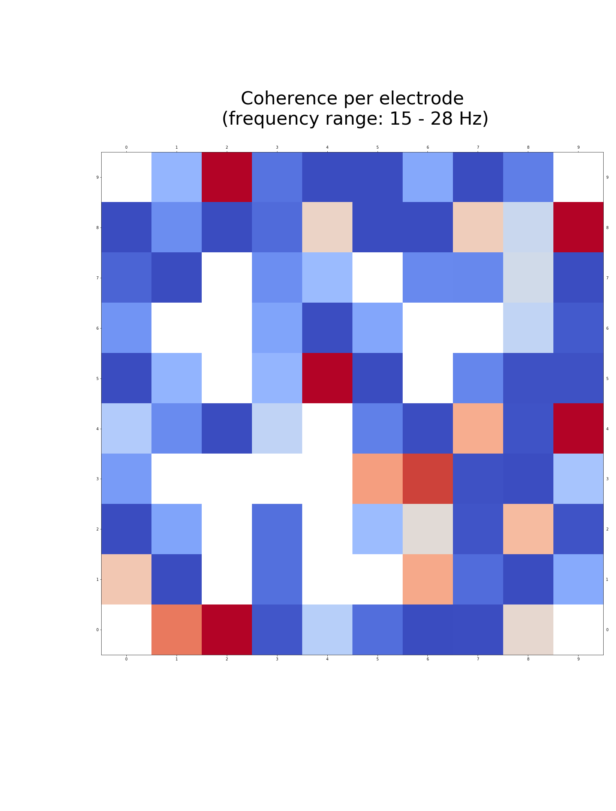
Spike-field coherence
0.01
0
- 0.01

Slide 11
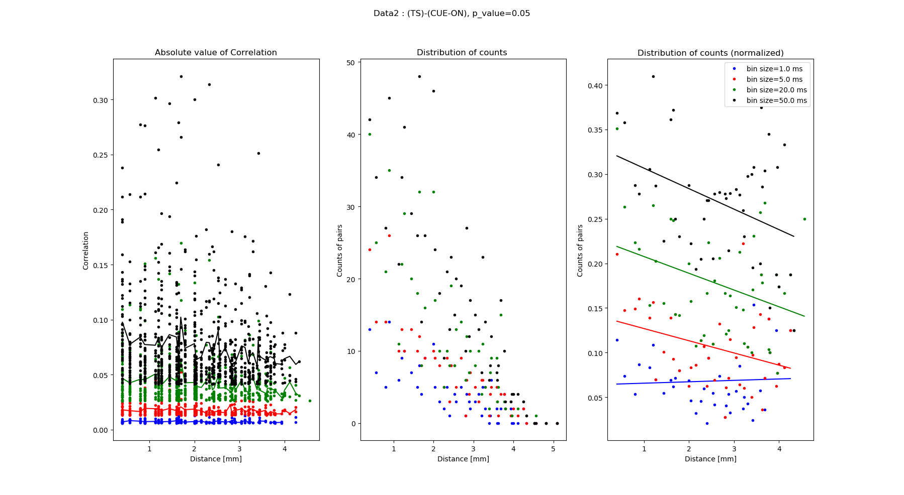
Correlation coefficient and distance

Slide 12
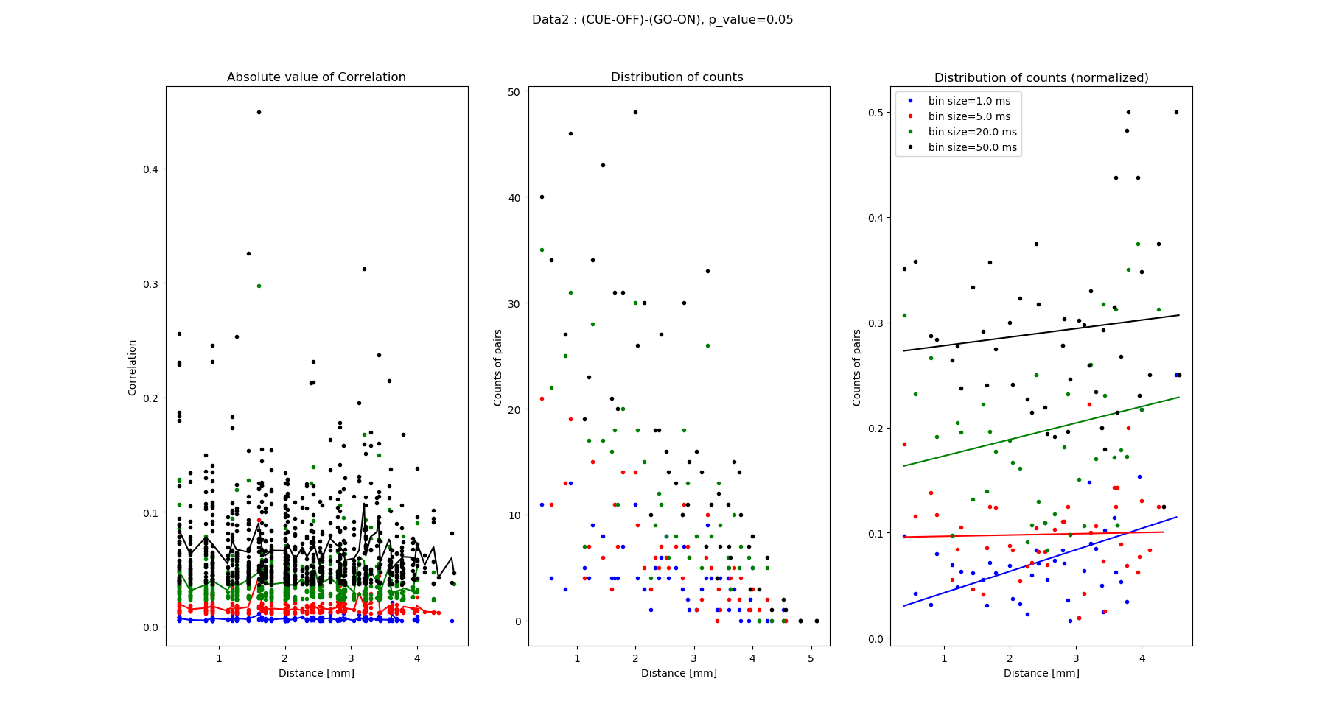
Correlation coefficient and distance

Slide 13
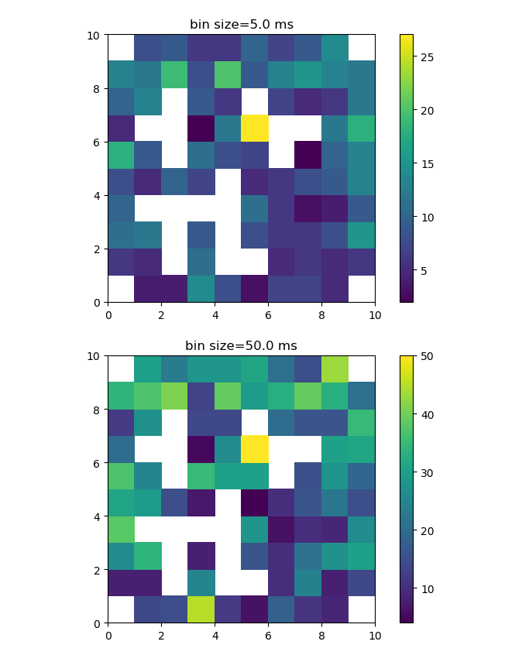
Spatial Distribution of correlation pairs

Slide 14
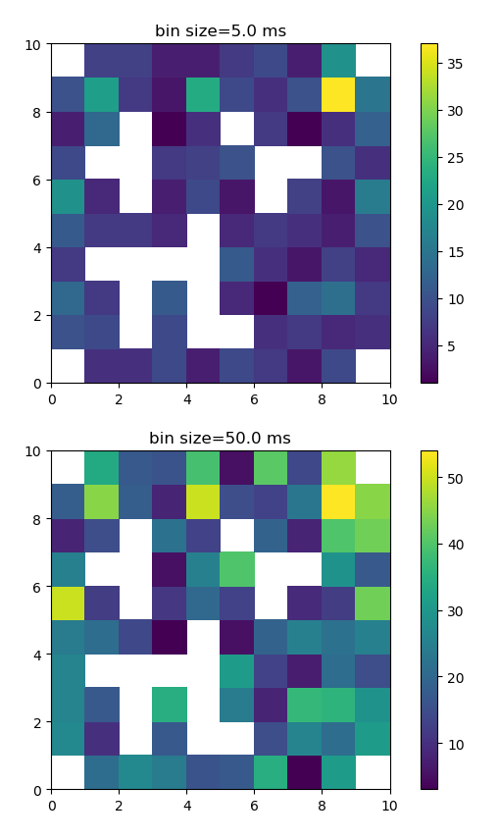
Spatial Distribution of correlation pairs

Slide 15
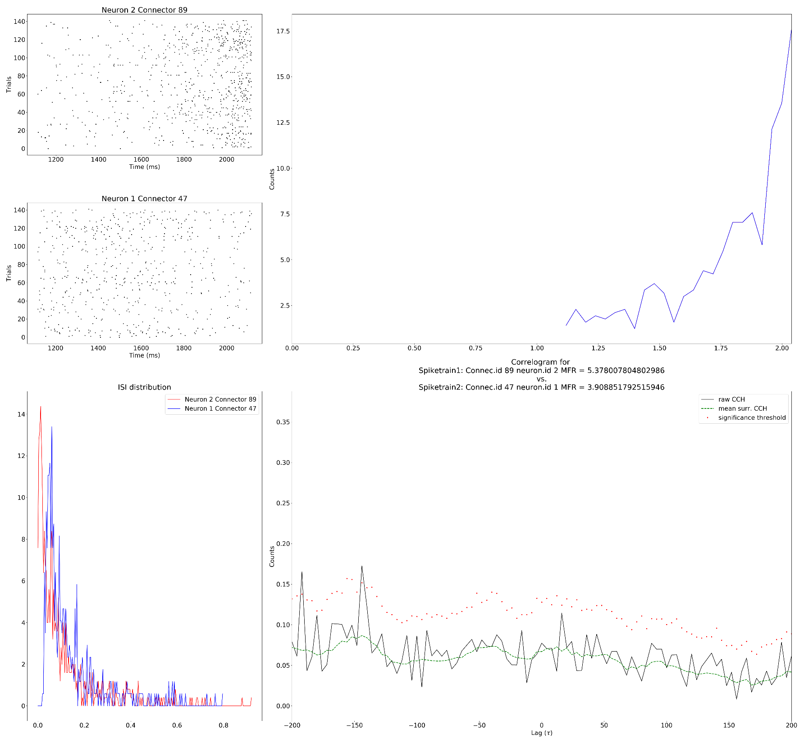
Spike-correlations – A closer look (cross-correlation)
# Set parameters
w = 4*pq.ms # binsize for CCH 1*pq.ms
maxlag = 200 # maximum correlation lag dither = 12*pq.ms
n_surr = 30
surr_method = 'dither_spike_train'

Slide 16
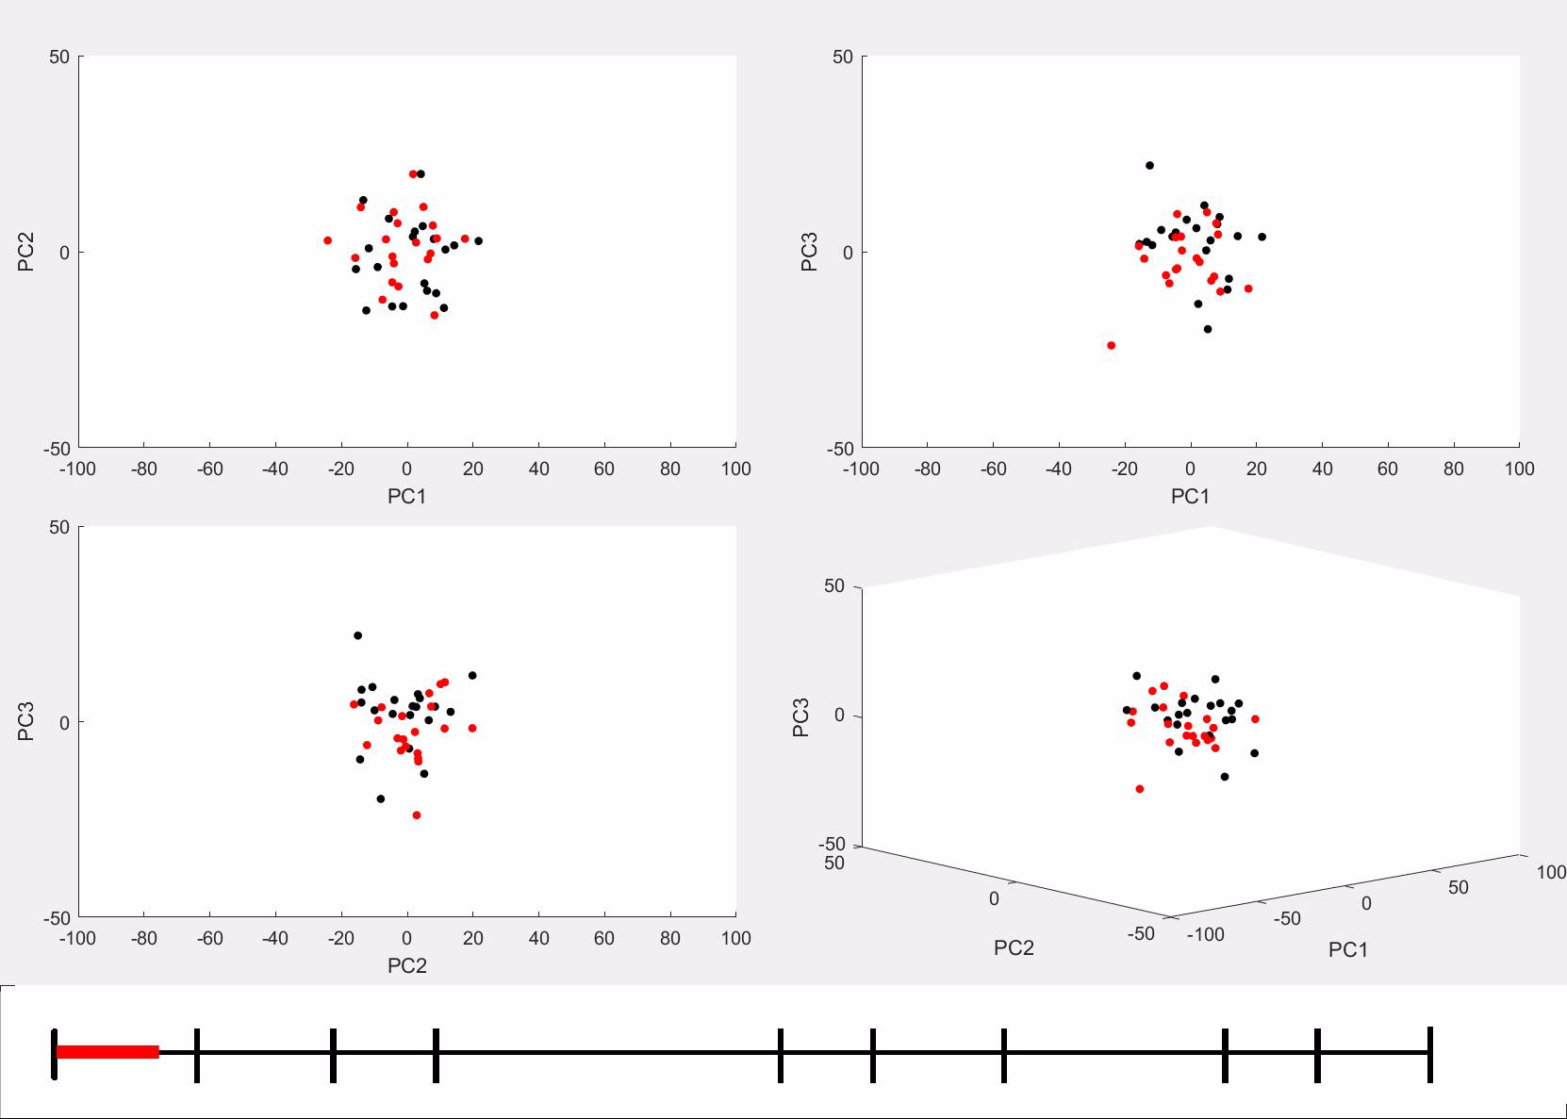
PCA clusters over time
PG SG
ts-
on
ws-
on
cue-
on
cue-
off
go-
on
sr
ot
do
rw-
on
stop

Slide 17
Task-related-information last until end of trials
distance
ts-
on
ws-
on
cue-
on
cue-
off
go-
on
sr
ot
do
rw-
on
stop

Slide 18
Conclusions
. Firing rate in prep period is correlated with RT
. Spiking correlations increase with distance
. This is probably not due to precise timing of firing, though
. Task-related activity is present until the end of the trial

Slide 19
More data

Slide 21
Bin size for psth calculation = 20ms. Time range [ts_ON, cue-ON].

Slide 22
Bin size for psth calculation = 20ms. Time range [cue-OFF, go-ON].

Slide 25
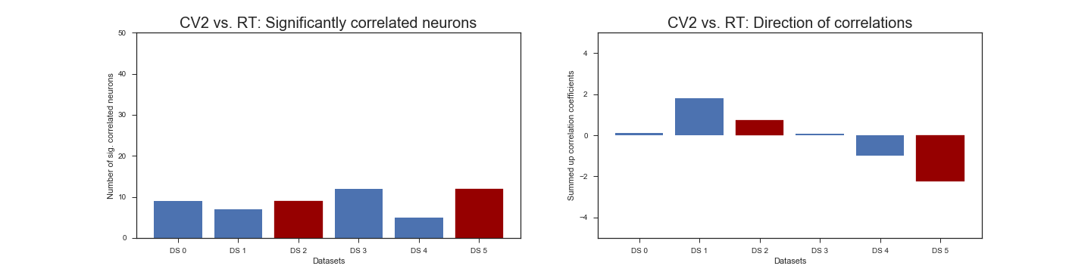
CV2 correlations with RT

Slide 26
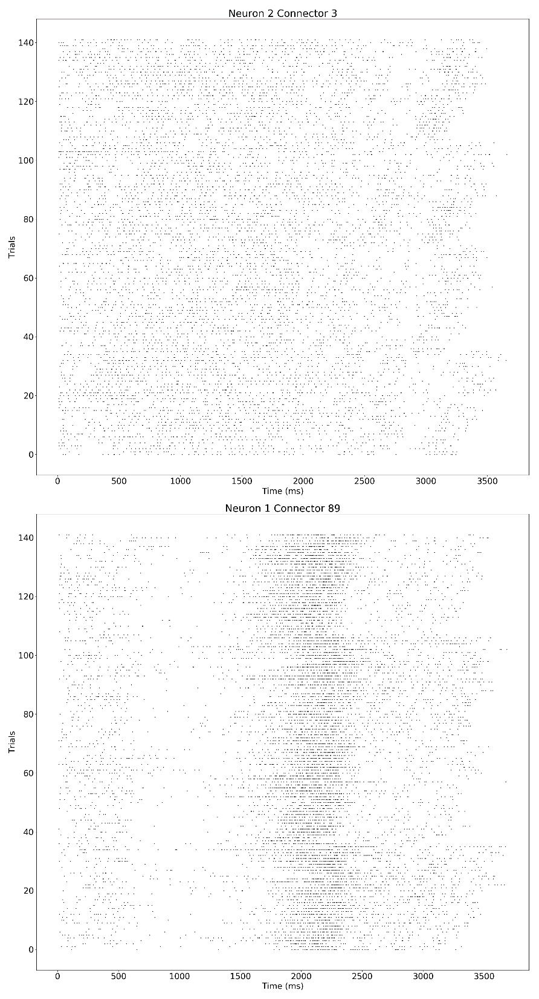

Slide 27
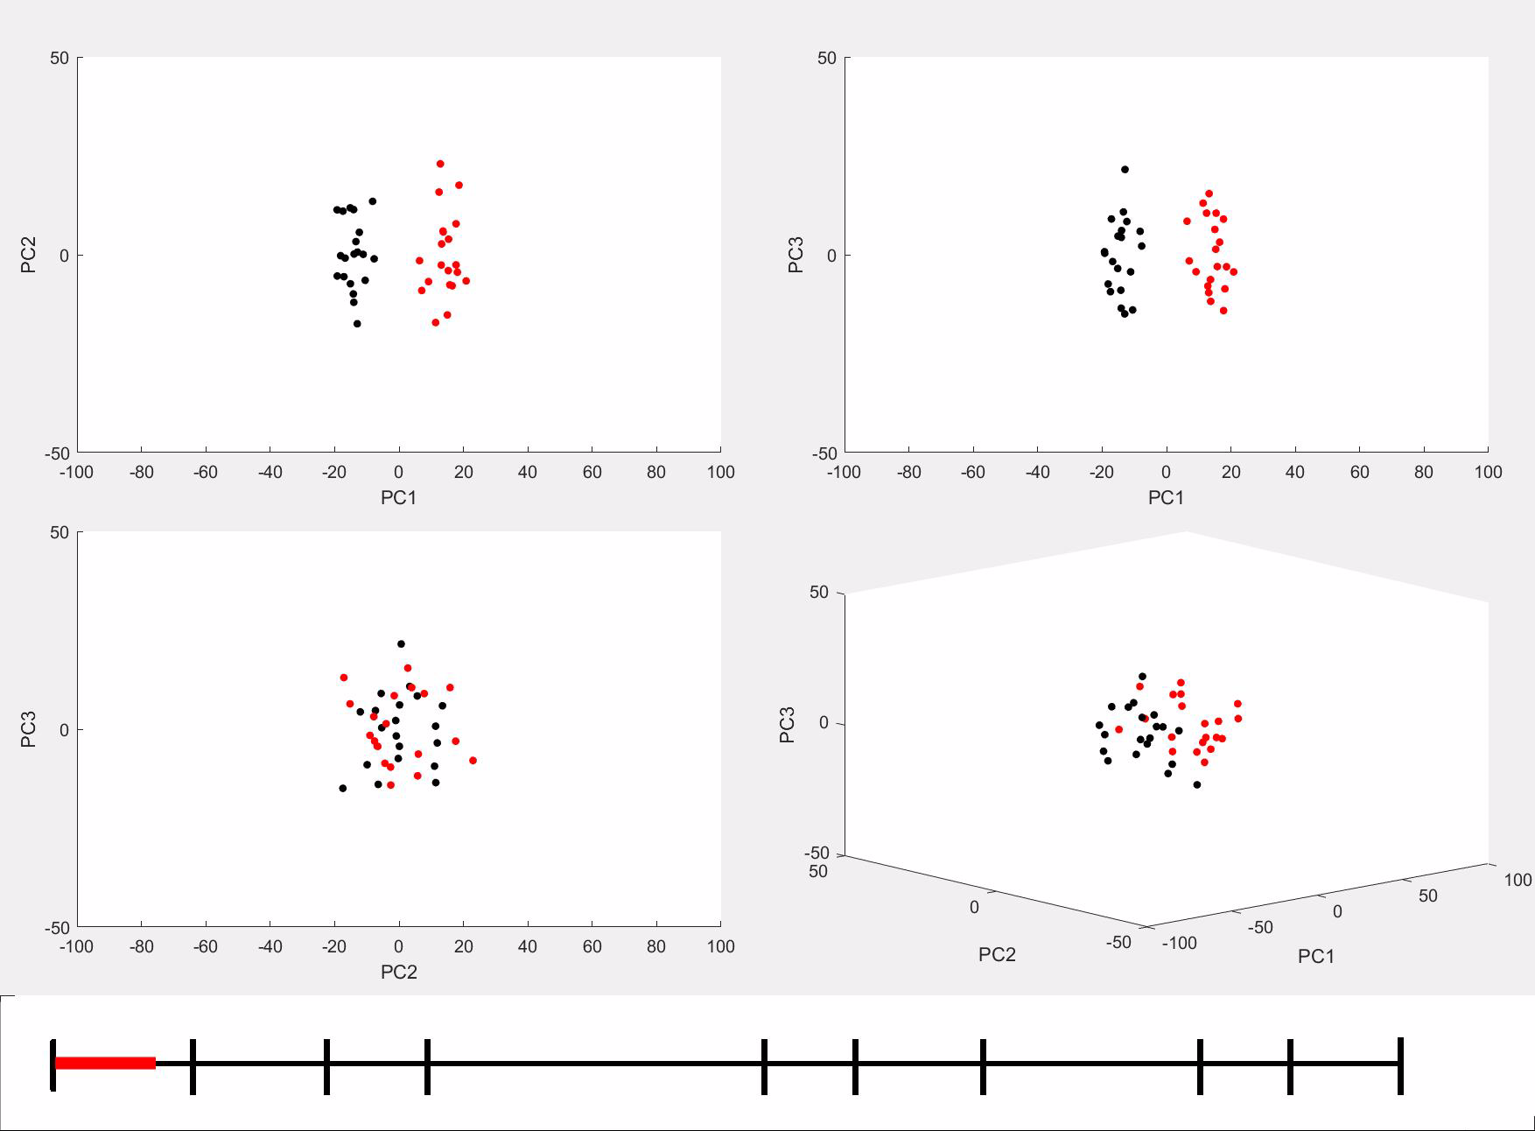
PCA clusters over time (Data3)
PG SG
ts-
on
ws-
on
cue-
on
cue-
off
go-
on
sr
ot
do
rw-
on
stop

Slide 28
Task-related-information last until end of trials
distance
ts-
on
ws-
on
cue-
on
cue-
off
go-
on
sr
ot
do
rw-
on
stop

Slide 29
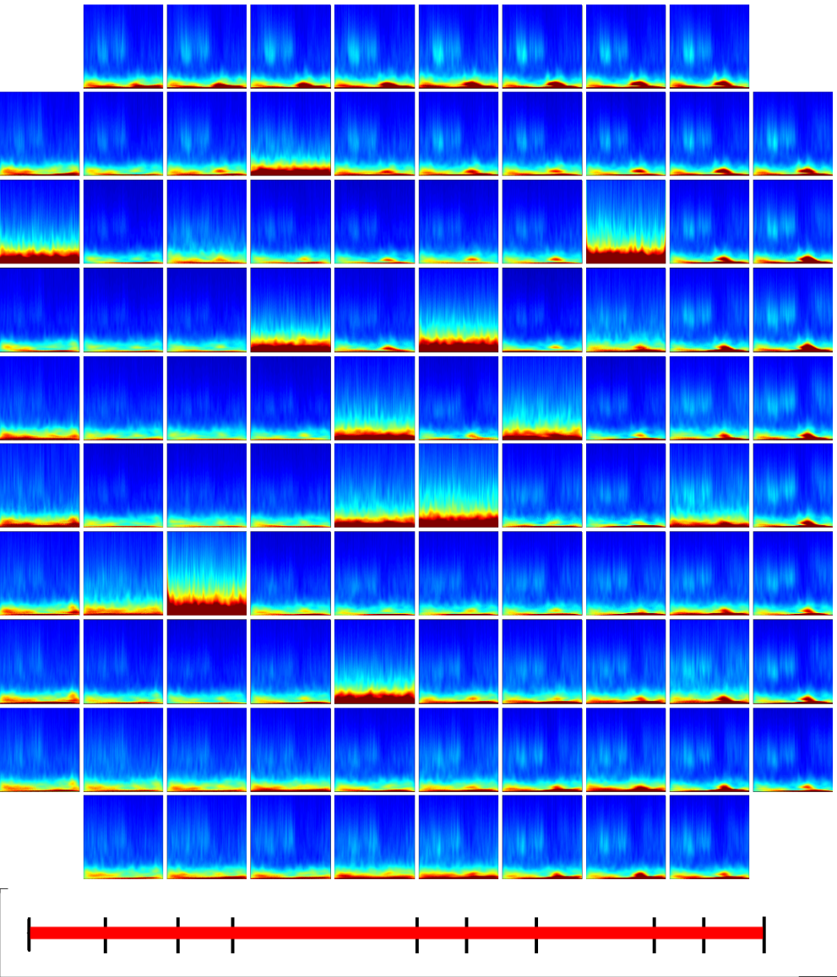

LFP
PG
SG

